Slide 1
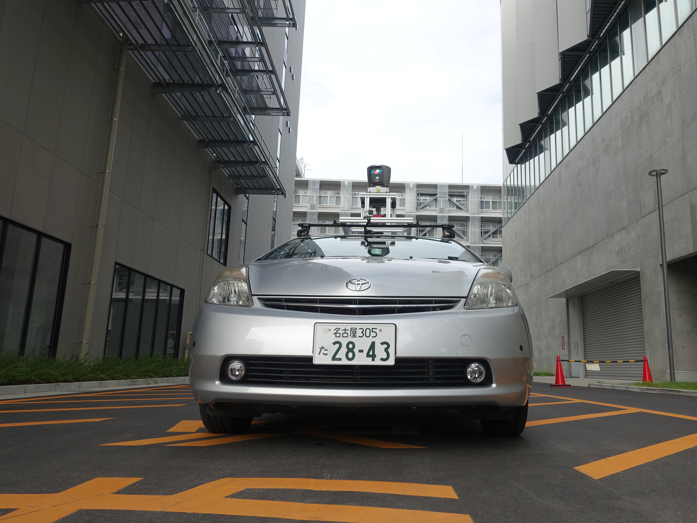
APEX 2015 Summary
Matthew O’Kelly, Houssam Abbas, Rahul Mangharam

Slide 2
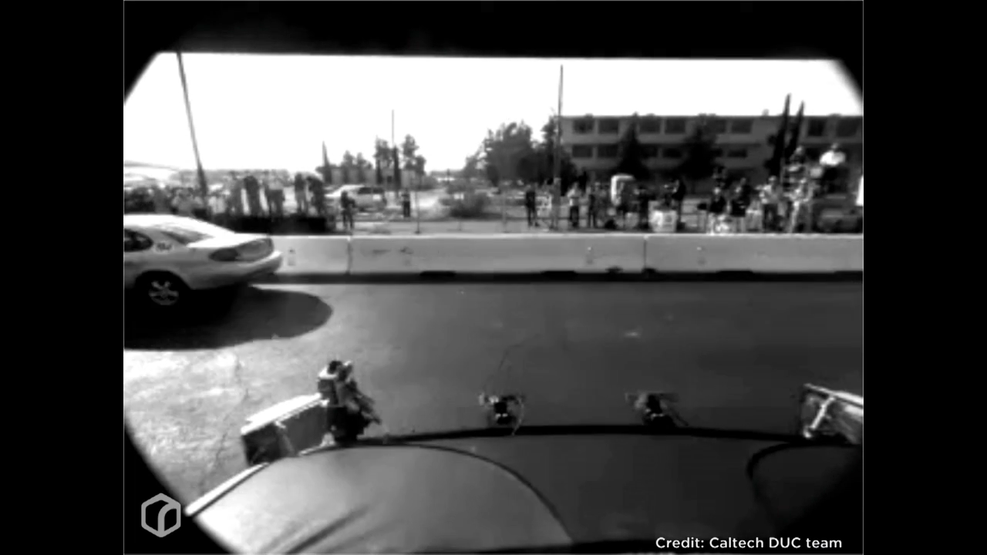
Motivation

Slide 3
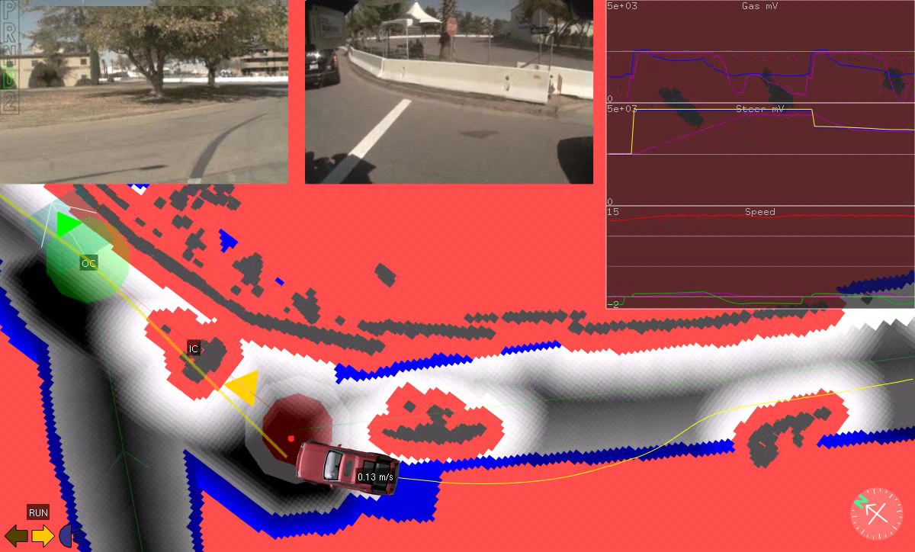

Slide 4
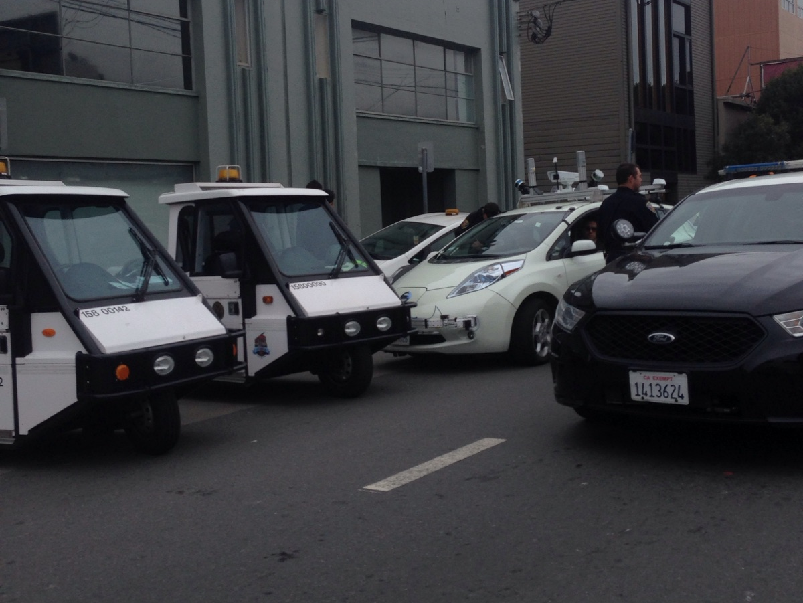
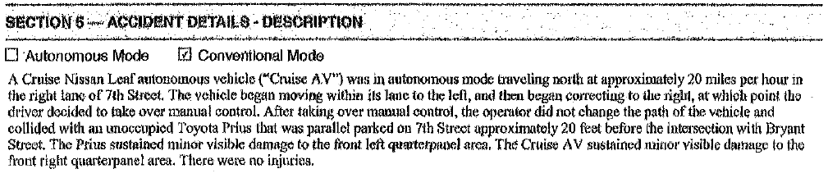

Slide 5
Summary of Current Work
Development of AV model
Development of hybrid systems framework to accommodate AV model
Development of tools to automatically generate model checkable scenarios
Expansion of modeling framework to incorporate more sources of uncertainty
Benchmark creation and uncertainty analysis
Development of framework for scenario creation from Open Street Maps.
Support for AV model in Unity and Rviz.

Slide 6
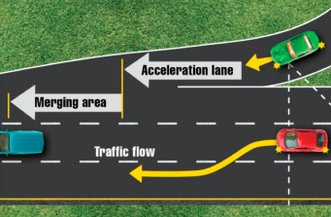
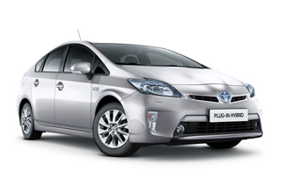
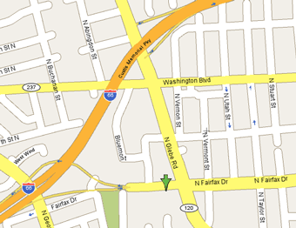

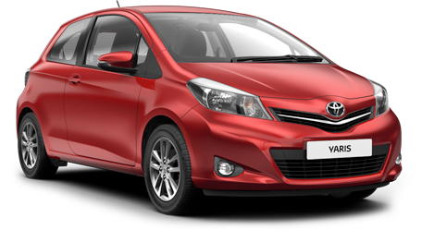


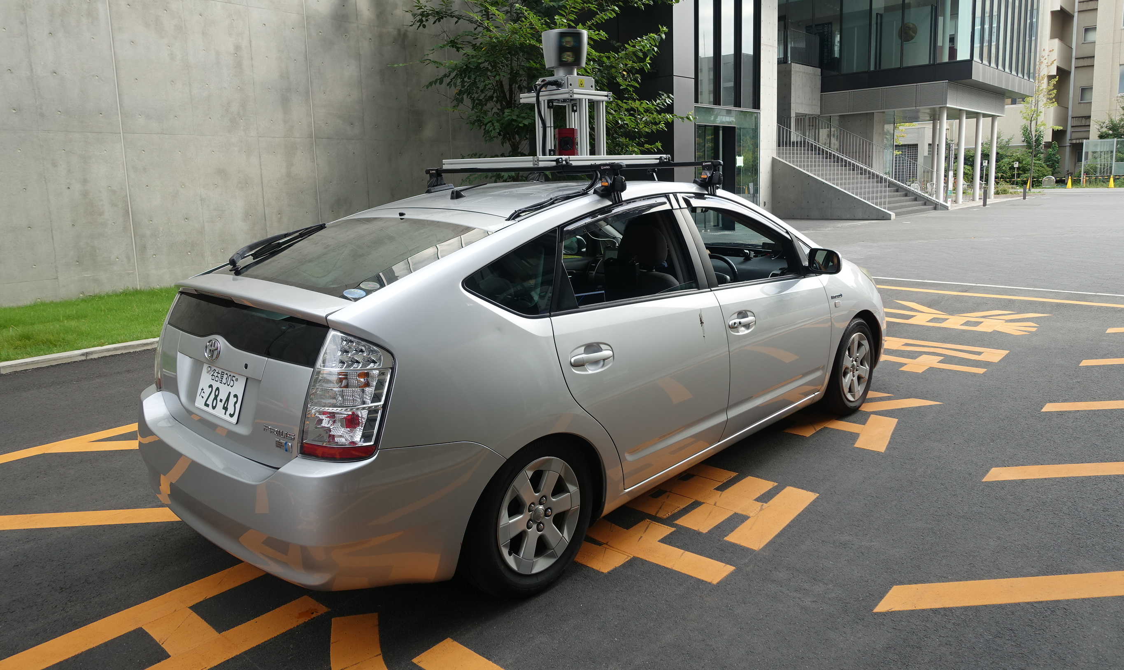
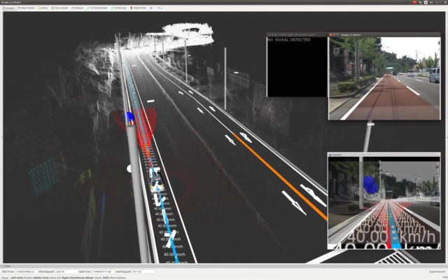
Summary of Approach
1
Explore the modeling of subsets of autonomous driving missions as scenarios
2
Map driving scenarios to collections of agents represented as hybrid systems
Driving Scenario
Target Vehicle
Road Network
Traffic Laws
Other Drivers
Pedestrians
Infrastructure
3
Implement state-lattice
planning stack in C++
Integrate ROS based vehicle OS
Validation of algorithms & software
4
5
Solution:
6
Reachability Problem
7
APEX automatically generates and solves a tree of reachability problems

Slide 7
Modeling Part 1

Slide 8
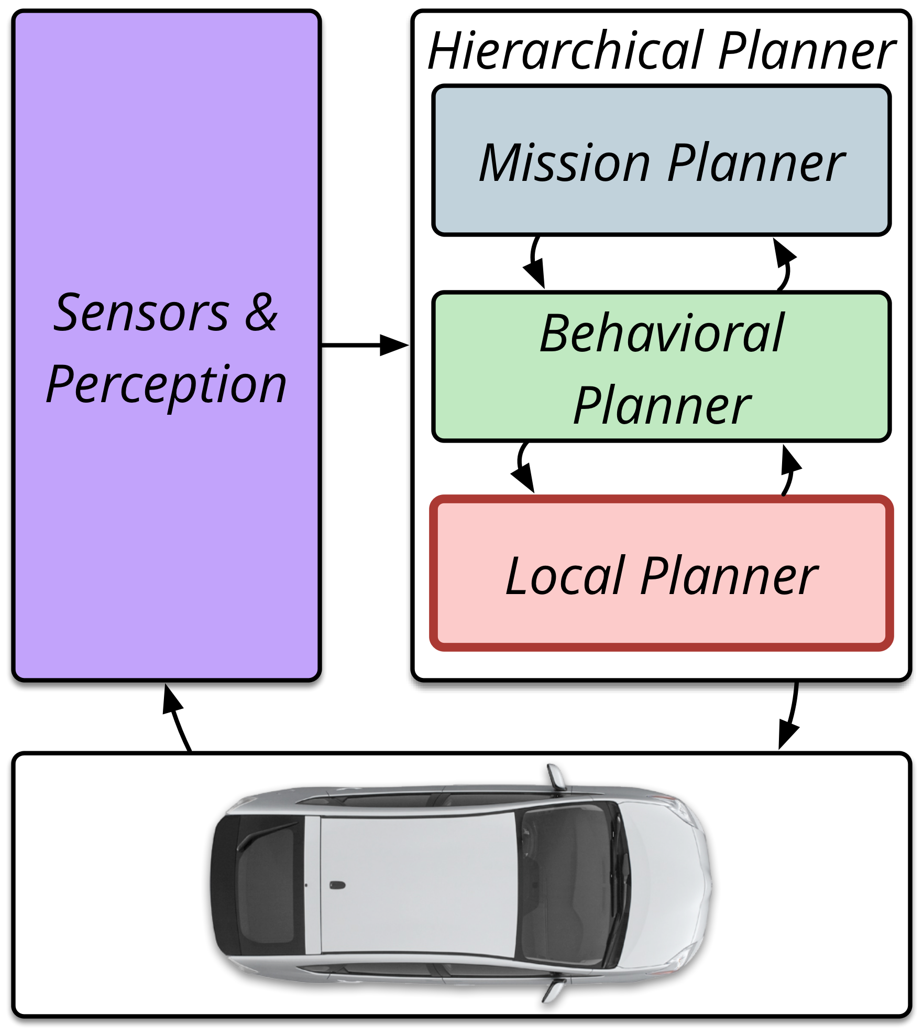
Basic Architecture

Slide 9
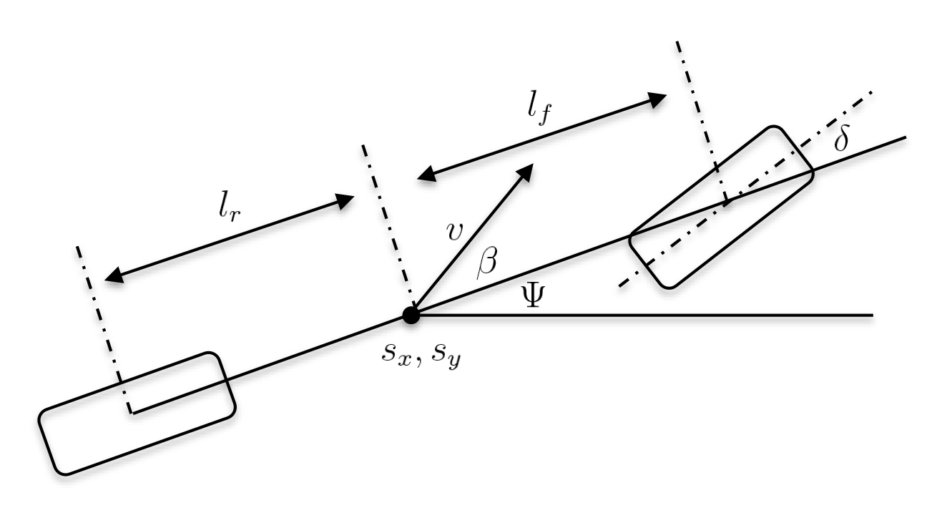
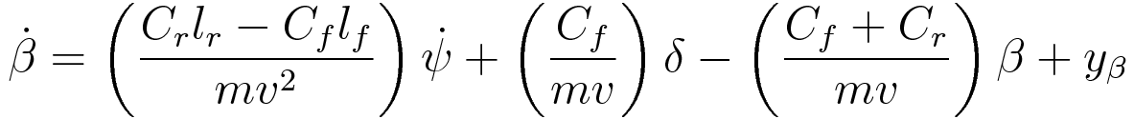
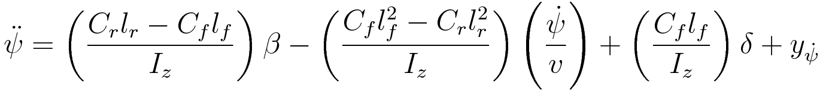
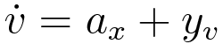
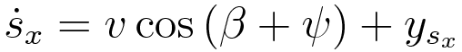
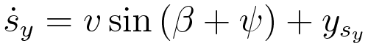
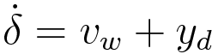
Vehicle Model
The bicycle model to is used as the intermediate representation (IR) because it supports verification of low level trajectory trackers and analysis with respect to first order logic necessary for formal verification.

Slide 10
Trajectory Generation

Slide 11
Behavior Controller: Two Representations

Slide 12
Scenario 1

Slide 13
Simple Lane Change

Slide 14
Specification

Slide 15
Verification Algorithm

Slide 16
Results: Composition of Trajectories

Slide 17
Results: Parallelization of Search

Slide 18
Results: Infinite Time Property

Slide 19
Complexity and Results

Slide 20
Modeling Part 2

Slide 21
Pure Pursuit

Slide 22
Sources of Non-Determinism

Slide 23
Scenario 2

Slide 24
Simple Lane Change

Slide 25
Specification

Slide 26
Variations

Slide 27
Complexity and Results

Slide 28
APEX Tool

Slide 29
Map Manipulation

Slide 30
Reference Trajectory Generation

Slide 31
Traffic Control

Slide 32
Agents

Slide 33
File Generation

Slide 34
Counterexamples

Slide 35
Next Steps

Slide 36
Next Steps: Proactive Driver Assistance

Slide 37
Summary

